Slide 2
NETFLIX Clone
Submitted to:
Department of Computer Science and Engineering

Slide 3
Supervised by: Prof. Gajendra Chauhan
Aryan Gupta

Slide 4
Project Presentation Outline
Introduction
Description
Website Structure
Technology used
Working
User Interface
Conclusions

Slide 5
Introduction
Our project, named "Netflix Clone," is a web application designed to replicate the front-end of the popular streaming service, Netflix. The goal is to create an interactive and user-friendly platform where users can explore content and sign up for an account.

Slide 6
Description
The Netflix Clone offers a simplified version of Netflix's front page, featuring a "Get Started" button and an email input field for user registration. The proposed solution aims to provide users with a familiar interface for discovering and accessing content while focusing on the sign- process.

Slide 7
Website Structure
Components:
Main Navigation Bar
Featured Content Section
Categories and Genres
Sections:
Home
Footer(contact)
Sign In / Sign Up

Slide 8
Objectives
Create a user-friendly front-end resembling Netflix's layout.
Implement a seamless email registration process.
Gain hands-on experience in web development and database management.

Slide 9
Technology Used
Front-end: HTML, CSS
Back-end: PHP
Database: MySQL
Server: XAMPP
The chosen technologies were selected for their simplicity, ease of integration, and compatibility with web development requirements.

Slide 10
Working
Homepage Layout:
The homepage features a "Get Started" button.
An email input field is provided for user registration.
Database Integration:
PHP scripts handle user input and interact with the MySQL database.
User email addresses are stored securely in the database.
XAMPP Server:
XAMPP is utilized to run the Apache server for PHP execution.
MySQL database is managed using phpMyAdmin.
User Interaction:
Users click the "Get Started“ and “Sign-in” button and enter their email address.
PHP scripts validate and store the email in the database.

Slide 11
User Interface
Design Elements:
Consistent color scheme and branding.
User-friendly layouts.
Showcase of key pages (home, sign-in, sign-up).

Slide 12
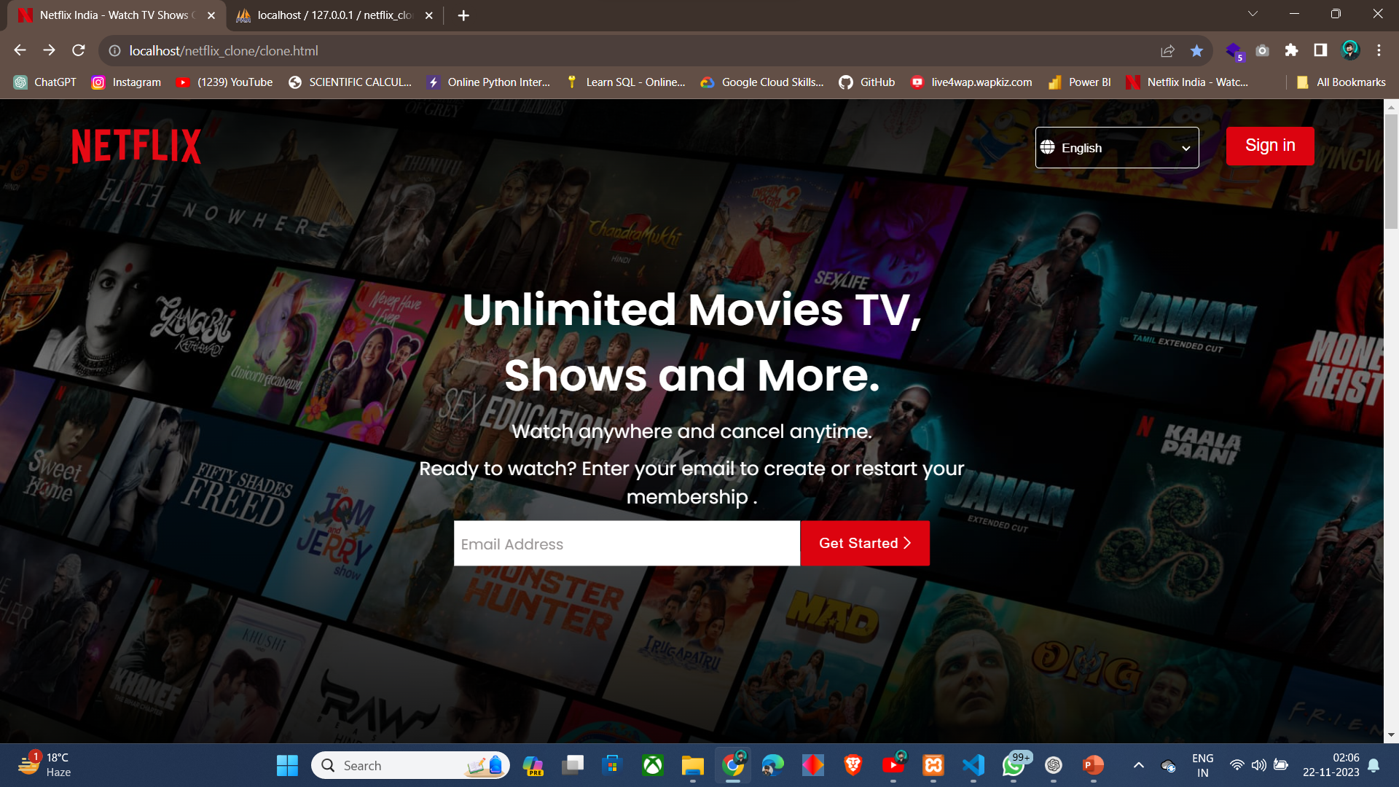
User Interface

Slide 13
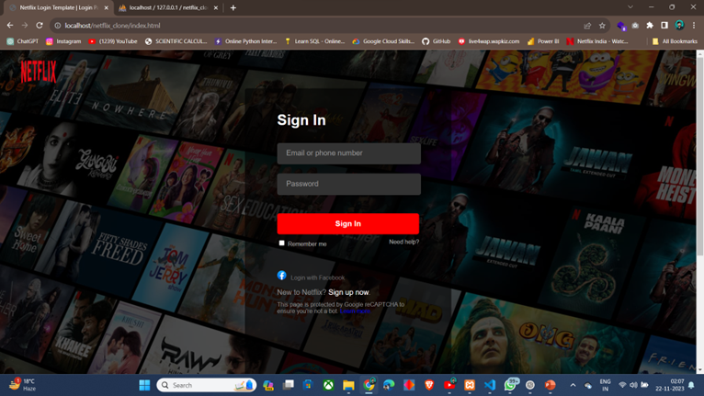

Slide 14
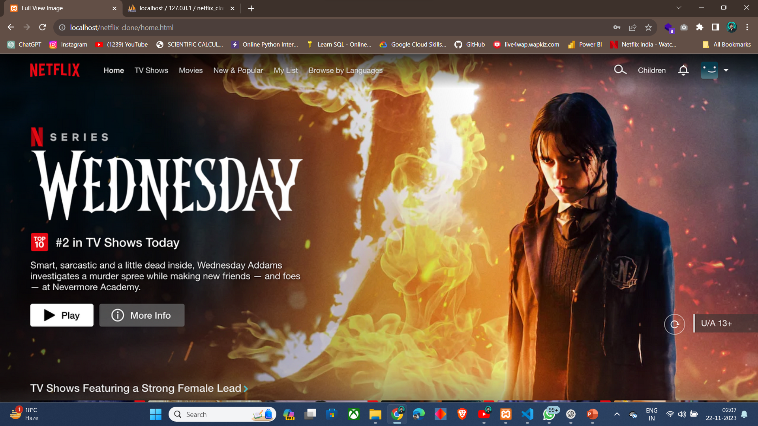

Slide 15
Conclusion
In conclusion, the Netflix Clone project successfully achieves its objectives by providing a functional front-end resembling Netflix's interface and implementing a user registration process. The project utilizes a stack of web development technologies and demonstrates the integration of PHP with a MySQL database. While a simplified version, it serves as a valuable learning experience in web development and server management.

Slide 16
Q&A

Slide 17
THANKS

